Slide 1
AP Chemistry Bellringers
February

Slide 2
AP Chem bellringer, 2/4/14:
The elements K and Cl react to form the compound KCl through the reaction below:
K (s) + ½ Cl₂ (g) → KCl (s) ΔH = -437 kJ/mol
How much heat is released or absorbed when 0.050 mol of Cl₂ (g) is formed from KCl?

Slide 3
Calorimetry Lab questions
Calculate the mass of food combusted (grams).
2. Calculate the change in temperature of the water (ΔT) due to heating by the fuel (°C).
3. The density of water is 1g/mL. Calculate the mass of water you heated (grams).
4. Calculate the heat flow in calories released by combusting your fuel, use the following formula and check your units: q = m*c*ΔT
Where: q is the heat flow (calories)
m is the mass of the water (grams)
c is the specific heat of water (c = 1 calorie/gram)
ΔT is the temperature change (°C)

Slide 4
Calorimetry questions, continued
5. One nutritional calorie is equal to 1000 calories, or one kilocalorie (kcal). How many nutritional calories were in your food sample?
6. The “energy density” of food is a measure of how many calories a food contains per gram. Calculate the energy density of your food (kcal/g).
7. Standard energy densities for different food groups are shown in the table below. Does the energy density of your food “make sense” in relation to these standard energy densities? Explain your answer.
Energy density (kcal/g)
Fats = 9
Carbohydrates = 4
Proteins = 4

Slide 5
AP Chem – February 7th, 2014
BELLRINGER:
Sign up to work the science fair either for the morning or afternoon session on Monday
Get a lab packet from the front table
Remember you are required to come help with set-up this afternoon in the girls gym! It should not take more than an hour.

Slide 6
Calorimetry Lab Groups + Data
Group 1: HB, Maddy, Rudy | Group 2: Max, Tyler | Group 3: Sabrina, Faith, Brittany | Group 4: Ty, Kuadrika, Kaylan | Group 5: Kadeem , Melvin | Group 6: Duffy, Taylor, Briceson
NH₄NO₃ | NaCl | NH₄NO₃ | NaCl | NH₄NO₃ | NaCl
Na₂CO₃ | LiCl | LiCl | Na₂CO₃ | LiCl | Na₂CO₃
MgSO₄ | MgSO₄ | NaC₂H₃O₂ | MgSO₄ | NaC₂H₃O₂ | NaC₂H₃O₂

Slide 7
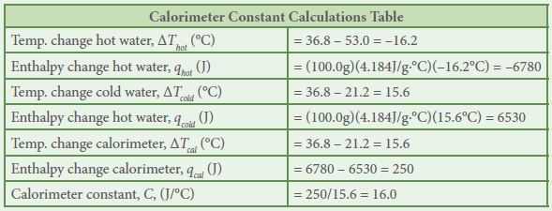
CHART!!!

Slide 8
Hand Warmer Lab!
Heading (Title, Date, Purpose): 5 points
Pre-Lab: 15 points (see below)
Cost chart: 3 points
MSDS analysis: 3 points
Intended procedure: 5 points
Calorimeter constant chart + calculations: 4 points
Data Collection (chart): 5 points
Calculations (questions 2 – 3): 6 points
Data Analysis (question 4): 10 points
Postlab assessment: 10 points*
*We will do this in class tomorrow. If your data is not ready for the discussion, you will lose points on the lab.
Conclusion: 4 points
CLEAN UP: 5 points TOTAL: 60 points

Slide 9
AP Chem – 2/17/14
Add your group’s lab data to the chart on the white board (every group needs this chart in their lab notebook)
Based on the cost information provided, and your experimental work and calculations, select which chemical you believe will make the most cost-effective hand warmer. Be prepared to discuss your answer with the class.
The hand warmer you are designing needs to increase in temperature by 20°C. Calculate the amount of the compound you selected that would be required for a hand warmer that meets this requirement.

Slide 10
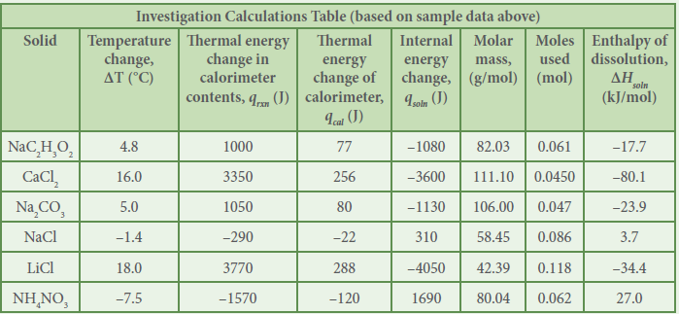

Slide 11
Homework + Extra Credit opportunities
Homework for Friday: Read Ch. 19 #s

