Slide 1
AP Chemistry bellringers

Slide 2
Warm-Up: January 8th
YOU WILL NEED YOUR LAB NOTEBOOK TODAY!
Get a “Thin Layer Chromatography” lab handout and powerpoint print-out from the front table
Start reading through the lab handout

Slide 3
Notes for today
Painkillers ranked by polarity:
Caffeine > acetaminophen > aspirin > ibuprofen
→ As long as you know this order, you don’t REALLY need to know the dielectric constants of the painkillers, just the solvents.
→ If you found them… bonus points!!!
Another note: my UV light doesn’t work. We will visualize ALL TLC plates in an iodine chamber.

Slide 4
Tips for TLC!!!!!
Homework:
Make your spots as small as possible
After your spots dry, spot them again. Repeat this a few times to make sure your spots will be visible.
Make sure your TLC chamber is airtight, and leave your eluent in the bottom with the lid ON for at least 5 minutes before you put your TLC plate in it.
Do not leave your TLC plate unattended. If your solvent front reaches the top, the results will be worthless.
Read sections 11.3 and 11.5 in your book (pgs. 437 – 438 + 442 – 443)
Answer the questions about viscosity, surface tension, and volatility on your Unit 5 Guide in your own words
Review section 11.2 (pgs. 428 – 436) and try practice exercises 11.1 and 11.2 (blue boxes). (These are optional, but they WILL be on the unit test.)

Slide 5
AP Chemistry Agenda – Monday, 1/13
12:50 – 1:00: Bellringer
Get a “troubleshooting TLC” plate from the front table and use it to start analyzing any errors your team found in your TLC plate. Write down ONLY YOUR RESULTS for now.
Save one FULL PAGE in your lab notebook to write and draw the results from every group
1:00 – 1:25: Sharing out and discussing results
During this time, EVERYONE should write down the results of each other group so that we can compare the results.
1:25: Ms. Rosencrans will pass out study guides
1:25 – 1:35: CLEAN UP!!! If there is time, you will be able to work on your lab write-ups.
LAB WRITE UPS ARE DUE TOMORROW!!!!

Slide 6
Questions to think about
Which painkiller(s) produced the best spots? Why?
If your TLC plate did not turn out well, what would you change in the future to make it turn out better?
If all had gone according to plan, which spot would have traveled the farthest distance? Which spot would have traveled the shortest distance? How do you know?
Why is it important to have a good understanding of solubility and polarity before you begin this lab?
Are there ways to improve solubility for different solutes? If so, how?

Slide 7
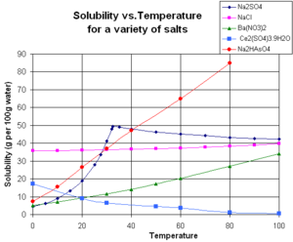
Would something like this have helped?

Slide 8
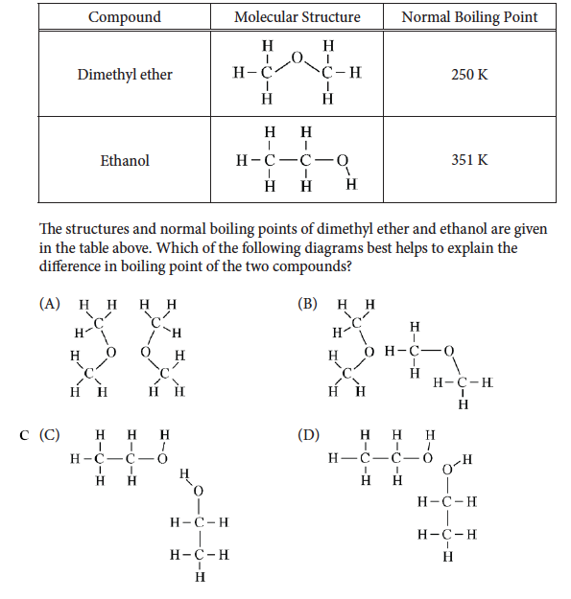
AP CHEMISTRY 1/14/14
Warm-Up →
Lab write-ups are due today! Put them in the basket!

Slide 9
AP Chem – Wednesday, 1/15
We will be testing the effect of each of the following on the freezing point and boiling point of water:
0.5 g salt 1.0 g salt
0.5 g sugar 1.0 g sugar
0.5 g baking soda 1.0 g baking soda
Choose which condition you want to test with your partner, and write your name next to that condition on the white board. Then you may begin!

Slide 10
AP Chemistry – Thursday, 1/16
Write your group’s lab data from yesterday on the board when you come in, and get a print-out of your graph from Ms. Rosencrans!
The melting point of water should have been 0°C and the boiling point should have been 100°C … why do you think our measurements were different?

Slide 11
Colligative Properties
Colligative properties are properties that depend on the AMOUNT of solute in a solution, and not the type of solute.
Examples of colligative properties are:
Decreased vapor pressure: adding a non-volatile solute will DECREASE the vapor pressure of a solution
Freezing point depression: adding a solute will decrease the freezing point (aka melting pt) of a solution
Boiling point elevation: adding a solute will increase the boiling point of a solution

Slide 12
Density of water
We all know that ice floats in water because it is less dense than water. Explain this phenomenon using particle diagrams.

Slide 13
Homework for tonight
Read pages 445 – 447 (section 11.6) and draw two phase diagrams in the “data analysis” section of your lab notebook: one for plain water, and one for water with a solute added

