Slide 2
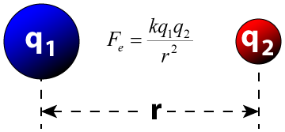
Warm Up – 11/11/13
Coulomb’s law states: The magnitude of the electrostatic force of interaction between two point charges is directly proportional to the scalar multiplication of the magnitudes of charges and inversely proportional to the square of the distance between them.
What does this mean? How does this relate to what we have learned so far in AP Chemistry?

Slide 3
Periodic Trends
Effective nuclear charge and atomic radius
Ionic radius
First and second ionization energy
Electron affinity/electronegativity
Properties of metal oxides
Properties of nonmetal oxides

Slide 4
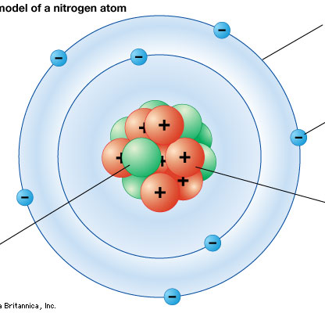
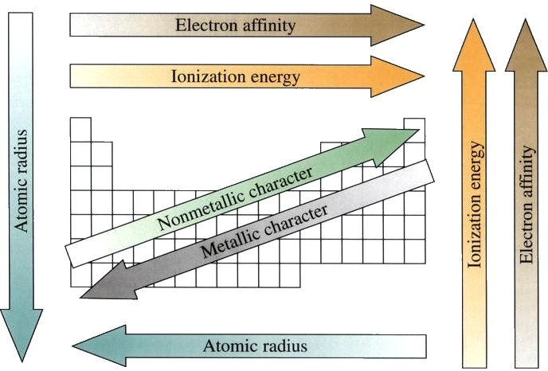
Below is a chart of periodic trends. Pick three, and explain (in terms of atomic structure) why each one occurs. Hint: think of this→

Slide 5
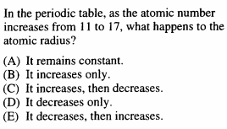
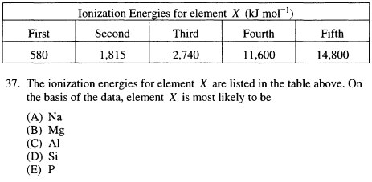
Warm-Up: 11/19/13

Slide 6
Warm Up – 11/20/13 Sit with your groups from yesterday and discuss:

Slide 7
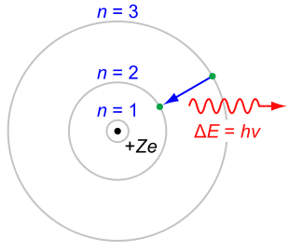

Slide 8
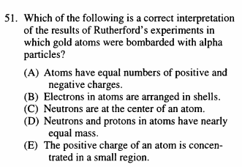
THROWBACK THURSDAY 11/21/13

Slide 9
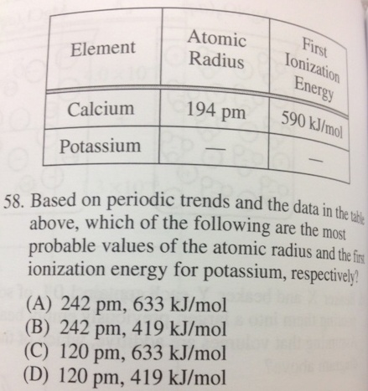
November 25th

Slide 10
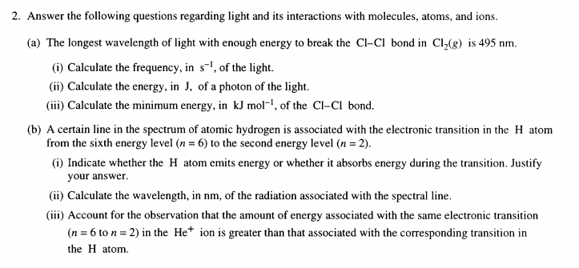
Due by the end of class: (one set of answers per group)
Notes:
Question 2; 1999 Free Response

Slide 11
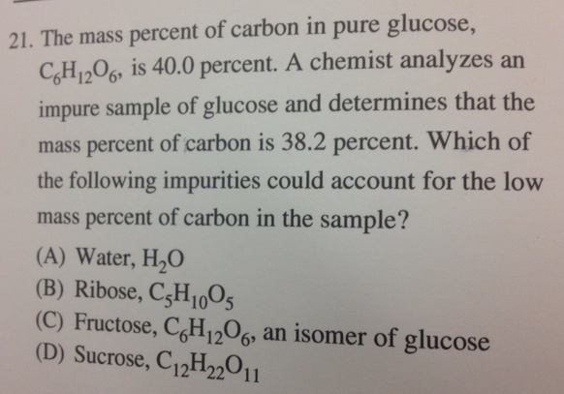
DATE

Slide 12
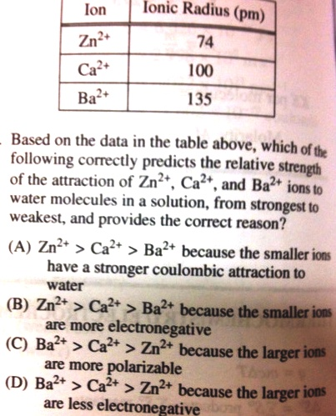

Slide 13
