Slide 1
TRASHKETBALL!!!!
Chemistry Olympics – Day 2
Warm Up: Your team will win 5 extra points if everyone is seated when the bell rings, plus another 5 points if everyone has study guides out
SPECIAL ANNOUNCEMENT: QUIZ BOWL TRYOUTS ARE TOMORROW AFTER SCHOOL IN MR. BROWN’S ROOM!!!!!!

Slide 2
3 points
Give an example of a heterogeneous mixture

Slide 3
3 points
Give an example of a physical change AND a chemical change

Slide 4
3 points
In which of the following do atoms have the LEAST energy?
Solids Liquids Gases

Slide 5
3 points
Give an example of an ionic compound (name only)

Slide 6
3 points
Give an example of a covalent compound

Slide 7
3 points
How many total oxygen atoms are in the molecule(s) Ca(NO₃)₂?

Slide 8
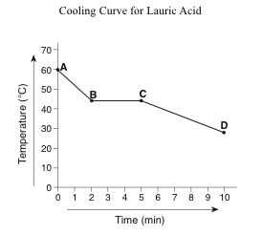
3 points
Based on the graph below, at what temperature does a phase change occur for lauric acid?

Slide 9
5 points
Give an example of an ionic compound (name and formula)

Slide 10
5 points
Give an example of a covalent compound (name and formula)

Slide 11
5 points
What is the name for the compound SO₂?

Slide 12
5 points
Which elements on the periodic table have the highest electronegativity? (Name at least 3)

Slide 13
5 points
Write the electron configuration for iron (Fe)

Slide 14
5 points
Draw an atom, and label all the subatomic particles (with charges) in the atom

Slide 15
5 points
Explain, in terms of protons and neutrons, why Cu-63 and Cu-65 are different isotopes of copper.

Slide 16
5 points
What is the equation for the ideal gas law?

Slide 17
5 points
Which has more valence electrons, an oxygen atom or an O²⁻ ion? Justify your response.

Slide 18
5 points
If the half-life of an element is 5 years, how long will it take for ¾ of the original amount to decay?

Slide 19
5 points
Hand warmers work by initiating a chemical reaction inside the pack that gives off heat. Is this reaction endothermic, or exothermic? Justify your answer.

Slide 20
10 points
Draw an orbital diagram for oxygen

Slide 21
10 points
Explain, in terms of kinetic molecular theory, how a hot air balloon works

Slide 22
10 points
5 points each:
a. Complete the reaction equation above by filling in the blank.
b. What type of reaction is this?

Slide 23
10 points
Draw the structural formulas for salt and water, then briefly explain (in terms of molecular structure) why salt is soluble in water.

Slide 24
10 points
The octet rule states that atoms are most stable when they have 8 valence electrons. Explain how this concept apples to the process of ionic bonding and the process of covalent bonding.

Slide 25
10 points
Creatine is a polar compound that athletes often take to build muscle. Would you expect creatine to be more soluble in water, or oil? Justify your answer.

Slide 26
10 points
John Dalton’s atomic theory stated that atoms are indivisible and cannot be destroyed or broken down into smaller parts. Explain whether or not you agree with this statement, and why.

Slide 27
10 points (Pre-AP only)
Draw three different models to represent the structure of water.

Slide 28
10 points
Select one of the models, and describe:
One aspect of the ammonia molecule that the model represents accurately/well and
One aspect of the ammonia molecule that the model does NOT represent well

Slide 29
15 points
Assuming R = 0.0821 L*atm/mol*K, use the ideal gas law equation to figure out how many helium atoms would be in a balloon with a volume of 1 liter at standard temperature and pressure (1 atm and 298 K)

Slide 30
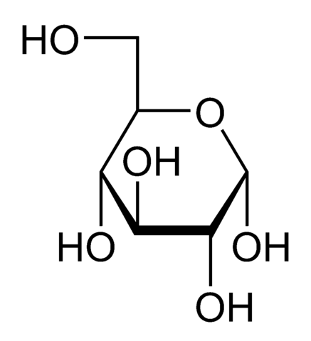
15 points (Pre-AP only)
The structural formula for sugar is shown below. Explain (in terms of molecular structure) why sugar is soluble in water.

