Slide 1
USING MOLES

Slide 2
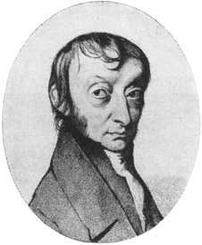
What is a mole?
A mole is 6.02 x 10²³ of anything!!!!
This number is also called Avogadro’s number, after the guy who invented it

Slide 3
Atomic mass units
AMU stands for atomic mass units
1 amu= 1 gram per mole = 1 g/mol

Slide 4
Practice!
Pb =
Al =
N =

Slide 5
Molar mass = mass of one mole
How do you find molar mass for a compound?
Find the molar mass for each atom, then add them up!
8. Find the molar mass for each of the following:
NaBr PbSO₄

